Slide 1
Animal identification
Dana Mills

Slide 2
Proper ID is important in managing the beef herd
As well as specifying ownership
ID helps follow an animal from the producer through marketing
Newer methods are being developed for this purpose
A leader in this effort is Allflex USA.
Company operates a research facility and collaborates with producers

Slide 3
Some beef animals will have permanent tags or other permanent forms of ID
If a tag is permanent, it can be tracked from the producer all the way through to the eventual harvesting of the animals
Being able to track an animal completely through the marketing system allows for greater food safety, greater quality control, and disease control.
There are several methods that may be used

Slide 4
Permanent systems
Tags
Branding
Earmarks
Neckbands
Tattoos
Others….

Slide 5
Tags
Usually placed in the ears of animals
Some are on chains around necks
Typically made of plastic
Have id numbers or letters
Aid in record keeping
Some tags allow electronic tracking using electronic codes sensed by a scanning device hooked to computers
This helps in accountability of animal health and quality

Slide 6
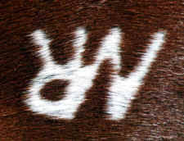
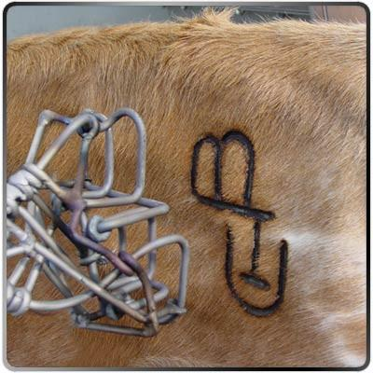
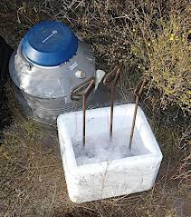
Branding
A permanent method of identification.
May be used with a hot iron or by freeze branding
Owners create a brand design and then registered with a state agency
Hot Iron
Burns the surface of the skin
Freeze branding
Uses liquid nitrogen with the iron
Freezes skin pigment
Depigments the hair follicles and allows the hair to grow back white in color
White-haired cattle – is left on longer to produce a bald spot the shape of the branding iron

Slide 7
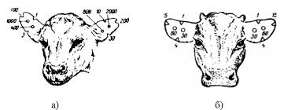
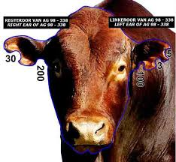
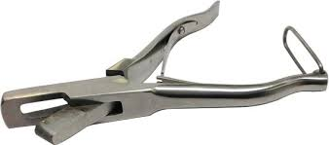
Earmarks
May be as simple as using a knife or an ear notcher to cut a notch in the ear.
With ear notches, a system is developed based on location in the ear using the left and right ears for the notches.

Slide 8
Neckbands
Neckbands or chains may also be placed on animals for ID.
Animals may tear the bands or chains or someone other than owner may remove them.
In rare cases, an animal may hand the chain or band, which could possibly choke animal to death.

Slide 9
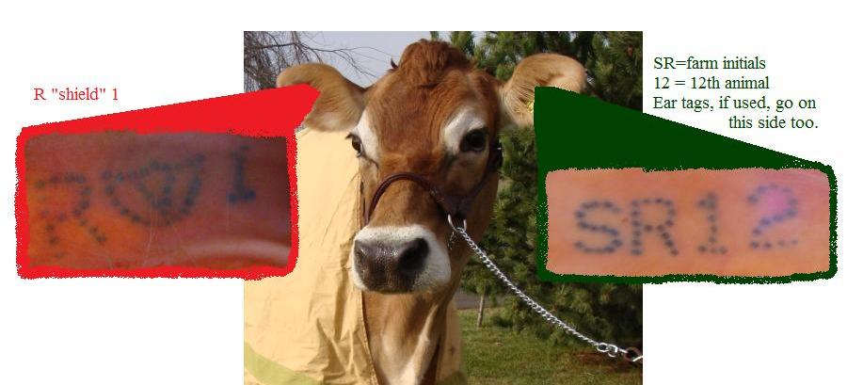
Tattoos
A method of ID frequently used among purebred breeders.
An instrument applies letters and numbers by piercing the skin
Ink is then rubbed into the area
Common place on beef cattle is the inside of the ear
Drawback – animal must be confined for the tattoo to be read
Also dark-skinned animals may be hard to read

Slide 10
Other methods
Nose Prints
Establish precise identity
DNA testing
Establish precise identity
Microchips
Placed under the skin
Not appropriate in animals to be slaughtered

