Slide 1
Benefits of the Horticulture Industry

Slide 2
Objectives
To explain the importance of horticultural products.
To recognize the aesthetic and recreational value of horticulture.
To identify environmental benefits and concerns.
To explore the economic role of the horticulture industry.

Slide 3
Main Menu
Introduction to Horticulture
Aesthetic, Recreational & Therapeutic Value
Environmental Value
Economic Value

Slide 4
Introduction to Horticulture

Slide 5
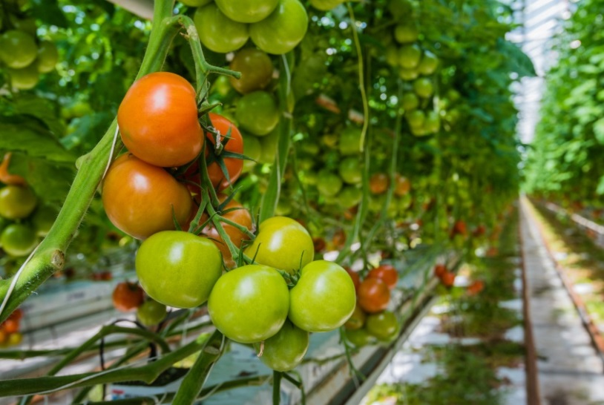
Horticulture
Is the cultivation of gardens, orchards or nurseries
Is the science and art of flowers, fruits, vegetables and ornamental plants

Slide 6
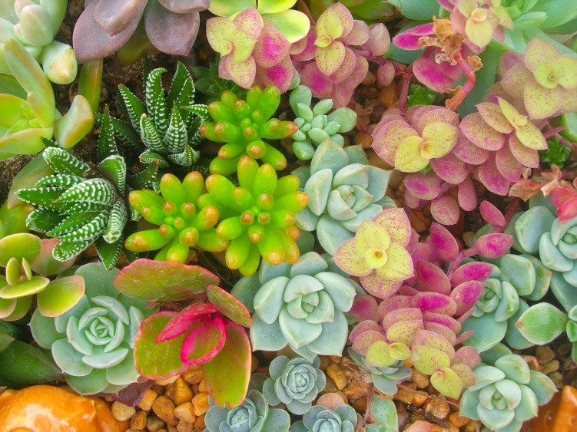
Horticulture
Provides many benefits, including:
aesthetic
recreational
therapeutic
environmental
economic

Slide 7
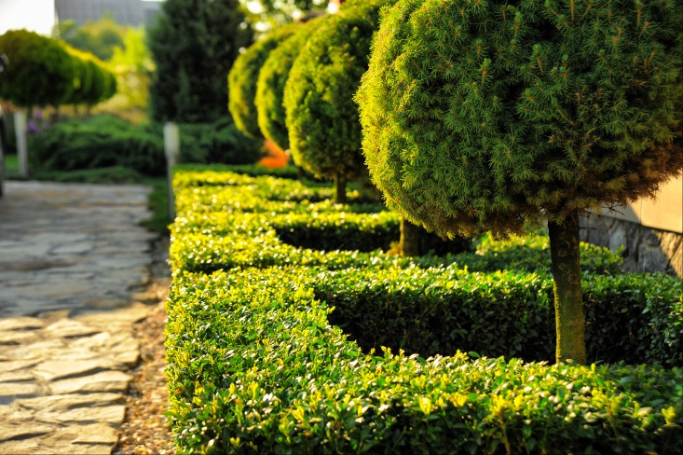
Branches of Horticulture
Include:
pomology
floriculture
olericulture
landscape horticulture
medicinal horticulture
nursery/plant propagation

Slide 8
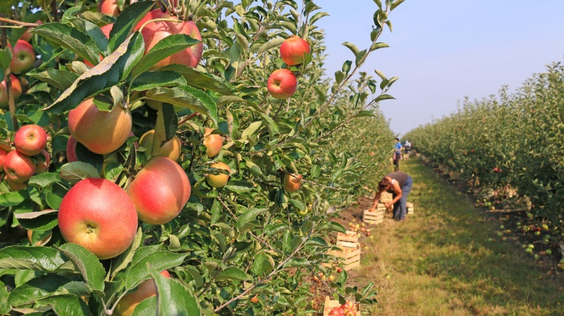
Pomology
Is the production and cultivation of fruit and nut crops
Includes the development of new fruits and the cross-breeding of various fruits for desired traits, such as:
hardiness
disease resistance
flavor

Slide 9
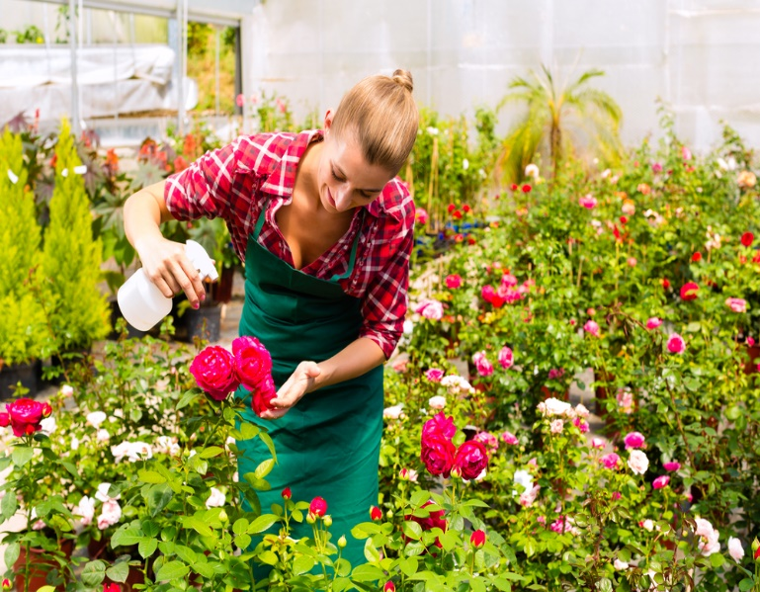
Floriculture
Includes the production, distribution and processing of flowers and foliage plants
Involves plants, such as:
bedding and garden plants
foliage plants
potted flowering plants
cut flowers
cut cultivated greens and floriculture material

Slide 10
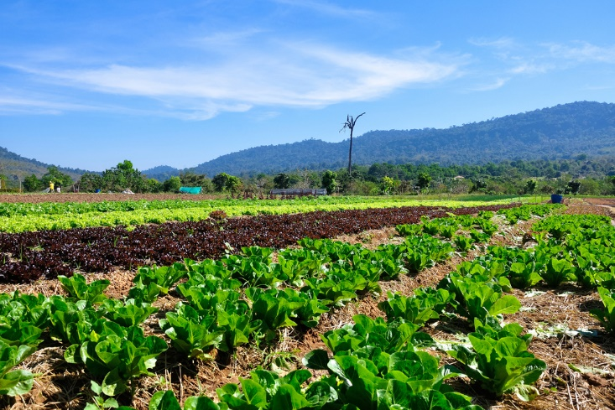
Olericulture
Is the production of vegetable food crops
Encompasses crop establishment, such as:
selection of seeds
seedbed preparation
establishment of vegetable crops by seed and transplants

Slide 11
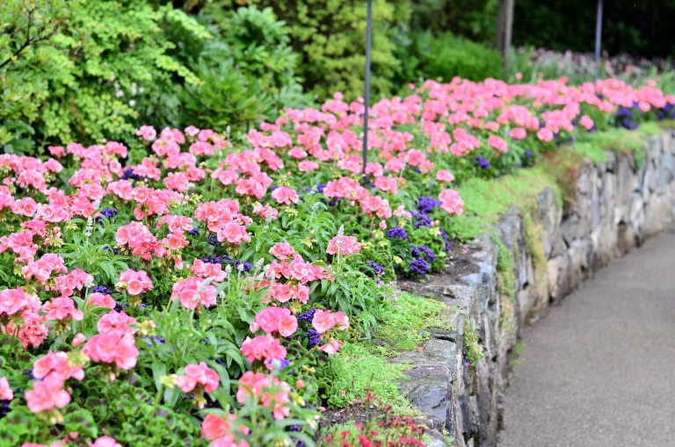
Landscape Horticulture
Is the production and use of plants to beautify the environment
Provides:
tranquility
aesthetic enjoyment
sense of enjoyment

Slide 12
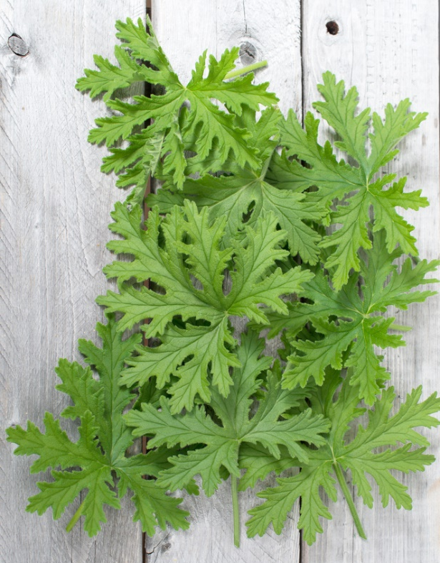
Medicinal Horticulture
Involves large groups of plants used in medicine and veterinary practice for therapeutic or preventative purposes
Provides:
synergic medicine
support of official medicine
preventative medicine

Slide 13
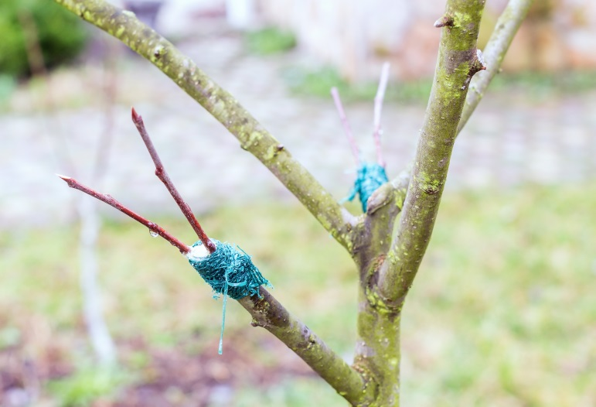
Nursery/Plant Propagation
Is a place where plants are grown for the sake of being moved or transplanted later
Is conducted through seed or vegetative practices, such as:
cuttings
grafting
tissue culture

Slide 14
Aesthetic, Recreational and Therapeutic Value

Slide 15
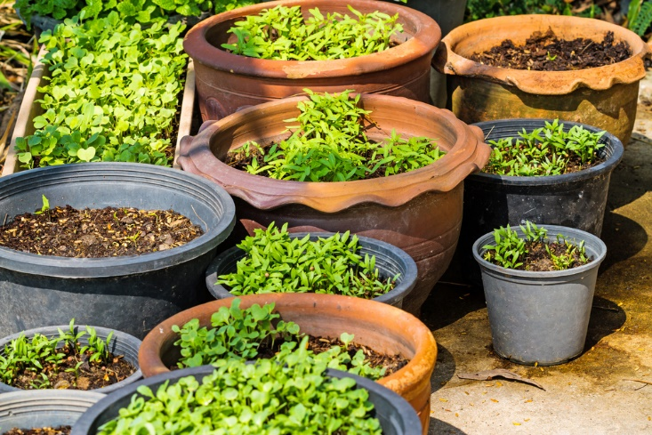
Plants
Have aesthetic, recreational and therapeutic value
aesthetics are pleasing in appearance; beauty
recreational is the means of refreshment or diversion; hobby
therapeutics provide or assist in a cure; curative

Slide 16
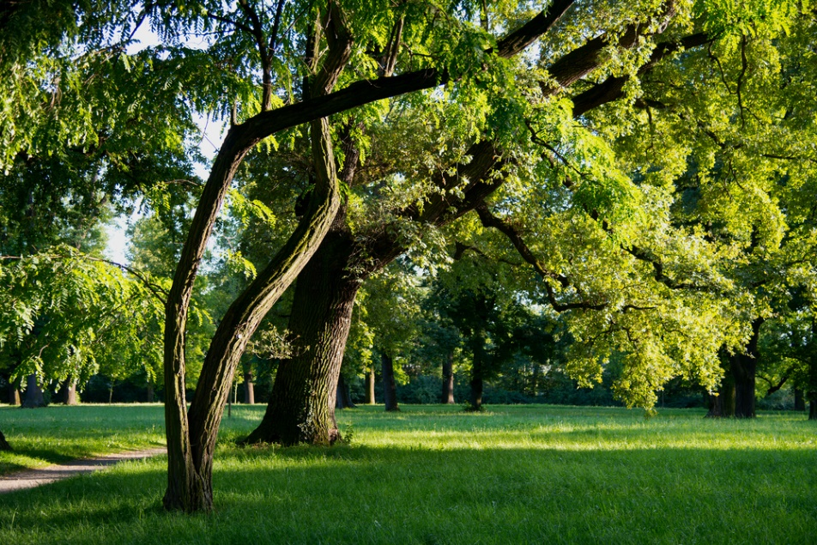
Plants
With aesthetic, recreational and therapeutic value include:
flowers
trees
bushes
garden plants
lawns

Slide 17
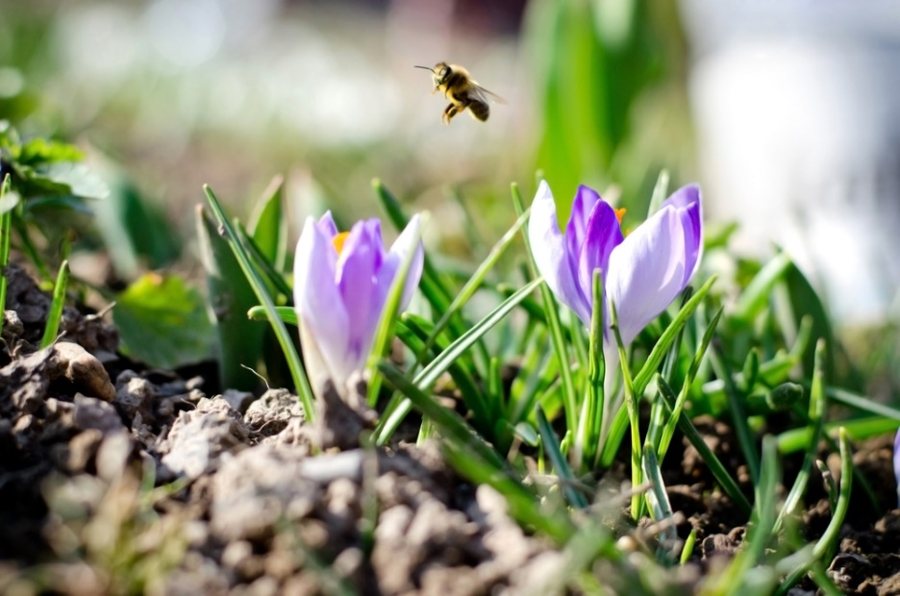
Flowers
Provide beauty
colorful blooms brighten up a room or space
Express emotion
often used as gifts and décor for special occasions

Slide 18
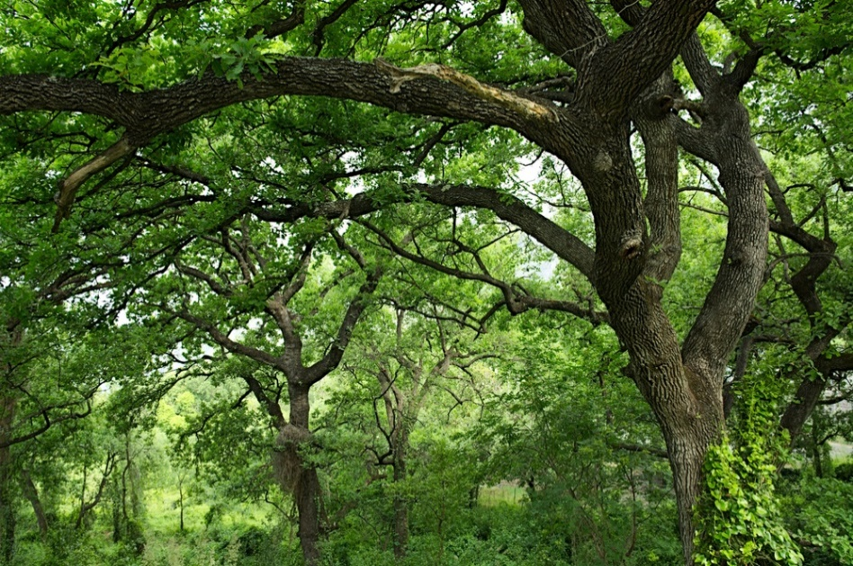
Trees
Provide shade
Can create a large-scale windbreak
groups of trees which protects an area from wind
Reduce pollution
Improve appearance of homes, parks and other landscape
often adds color, aroma and shade

Slide 19
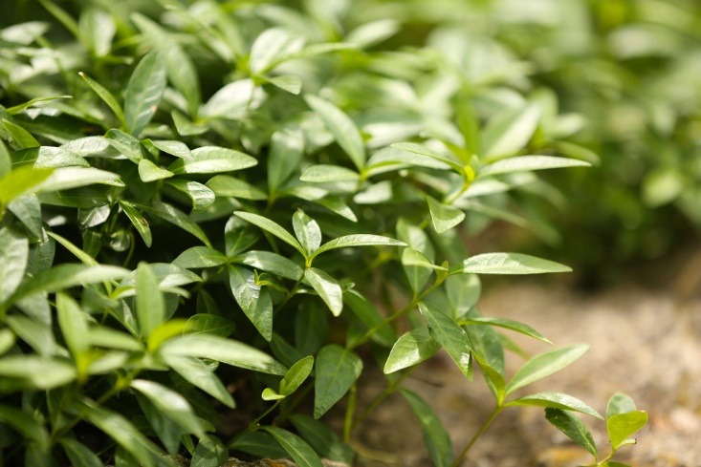
Bushes
Allow for a more natural environment
provides a place for reproduction and decomposition of birds, wildlife and other living organisms
Create a windbreak and shade for its surroundings

Slide 20
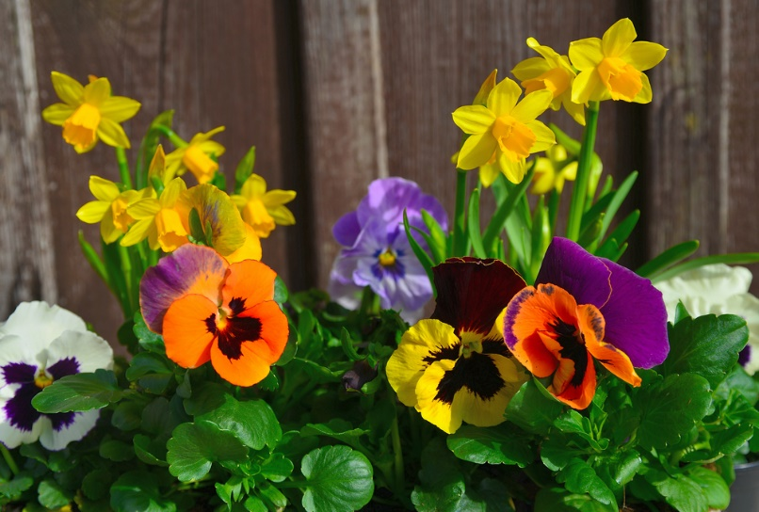
Garden Plants
Are produced by hobbyists and large-scale operators
Provide food for families on a non-commercial scale
Impact the environment by:
cleaning the air
absorbing carbon dioxide
releasing fragrance

Slide 21
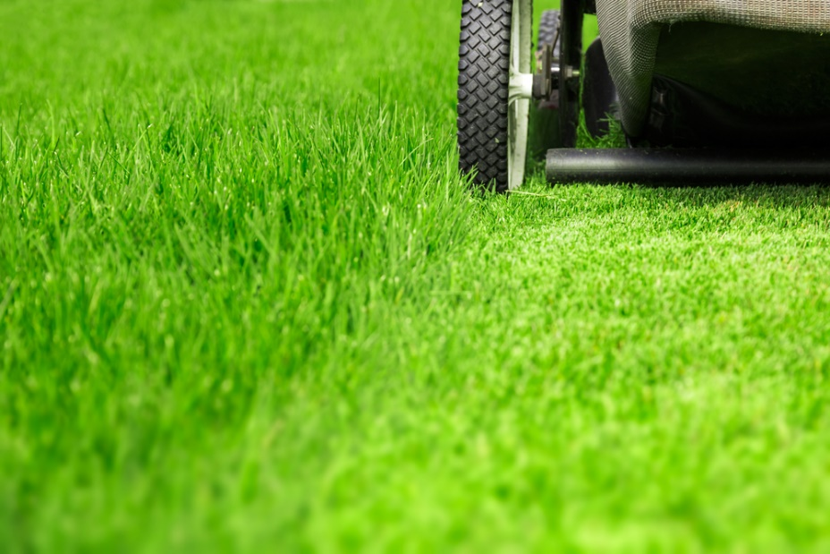
Lawns
Offer aesthetically pleasing backdrops for other landscape plantings as well as environmental benefits
preserve and protect soil, air and water resources

Slide 22
Environmental Value

Slide 23
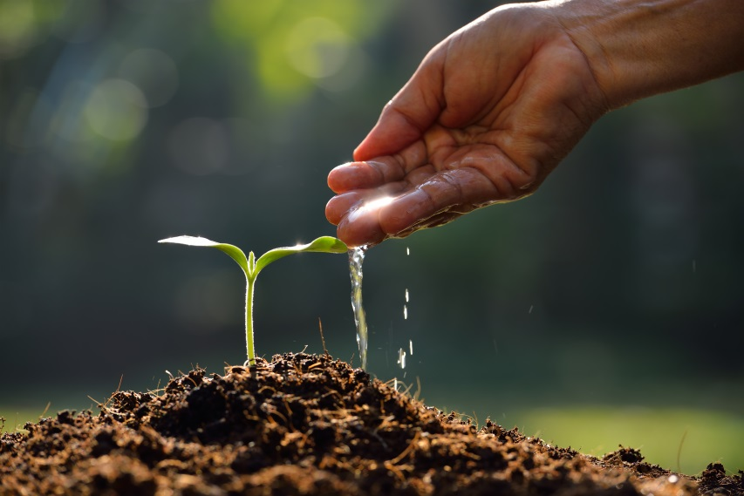
Plants
Have environmental value
plants impact the air, water, minerals, organisms and other biotic factors in their surroundings

Slide 24
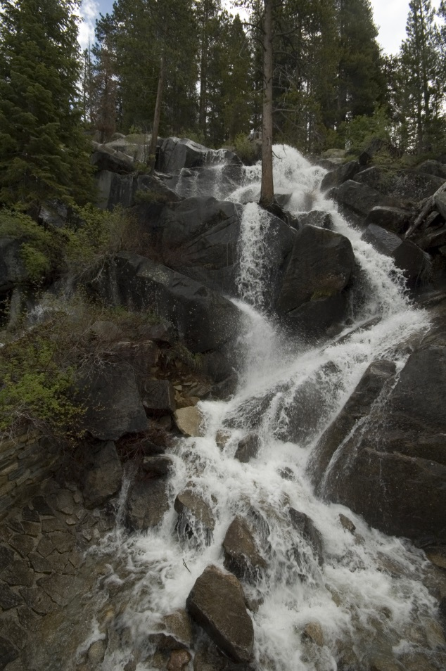
Plants
Impact the following environmental factors:
air
soil
animal life
erosion
run-off

Slide 25
Air
Is impacted by horticulture
plants produce oxygen and remove carbon dioxide from the atmosphere
plants enhance air quality by reducing toxins through a process called phytoremediation

Slide 26
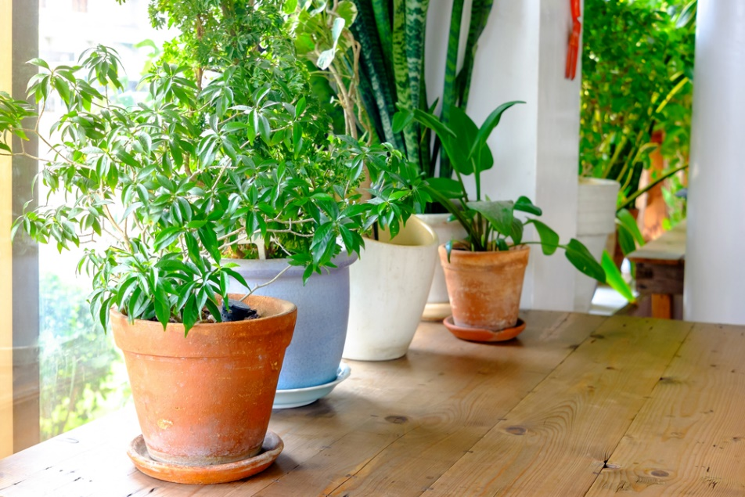
Plants
Are often used to improve indoor air quality in homes and workplaces
Utilized indoors include:
ivy
ferns
potted flowers
small trees
shrubs

Slide 27
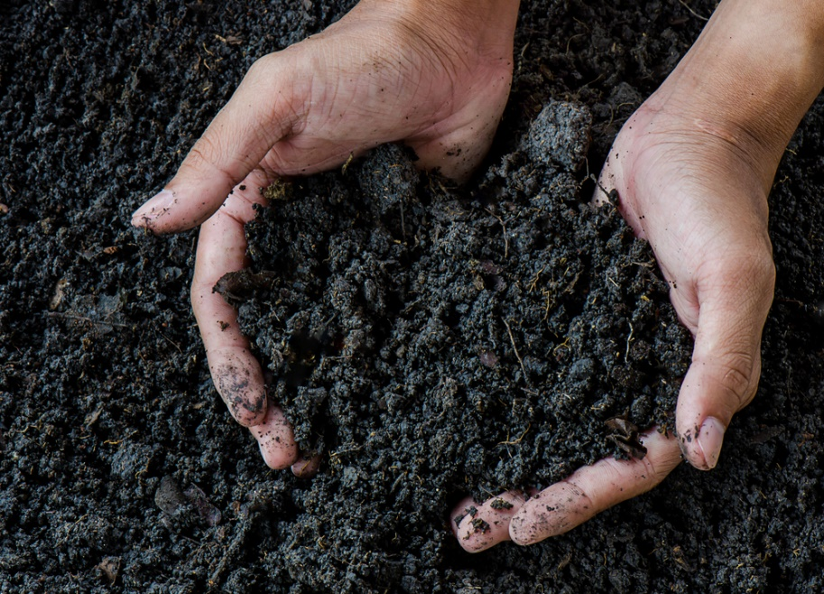
Soil
Provides habitat for bacteria, insects, burrowing mammals and other organisms
Recycles raw materials
Provides plant benefits, such as:
stability
oxygen
nutrients

Slide 28
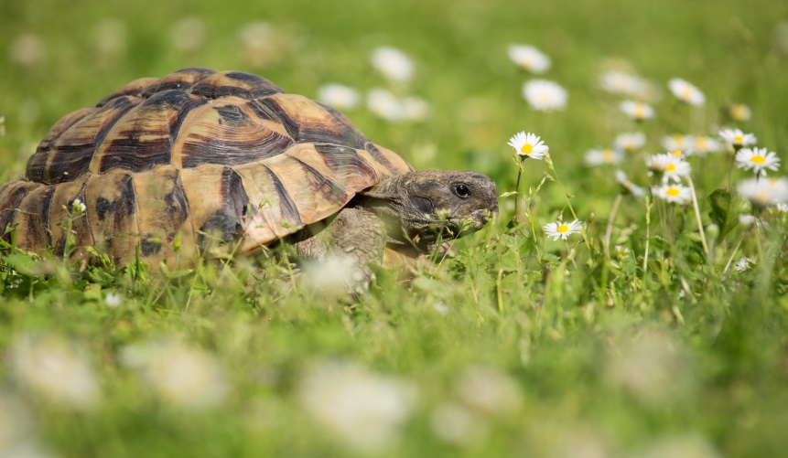
Animal Life
Is affected by horticulture
plants are a food source for many animals
plants make up much of the physical and biological environment for the everyday necessities of animals

Slide 29
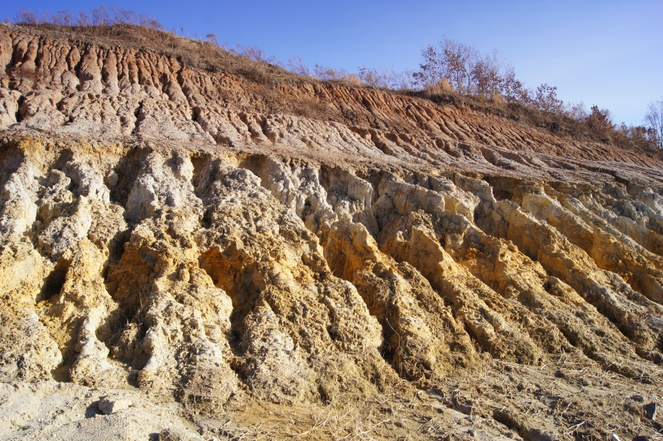
Erosion
Is the process by which the surface of the earth gets worn down

Slide 30
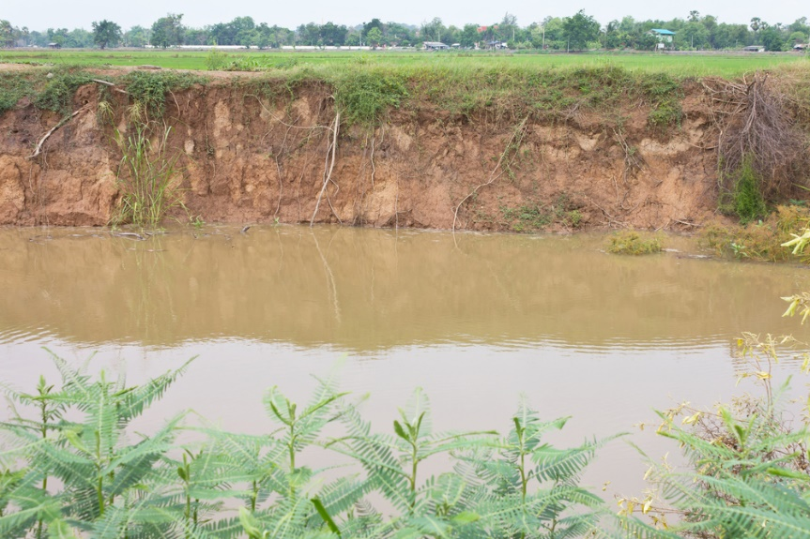
Erosion
Is impacted by horticulture
plants provide protection to the soil
plants slow down water as it flows over the land
roots of the plants hold the soil in position
plants break the impact of raindrops before they hit the soil

Slide 31
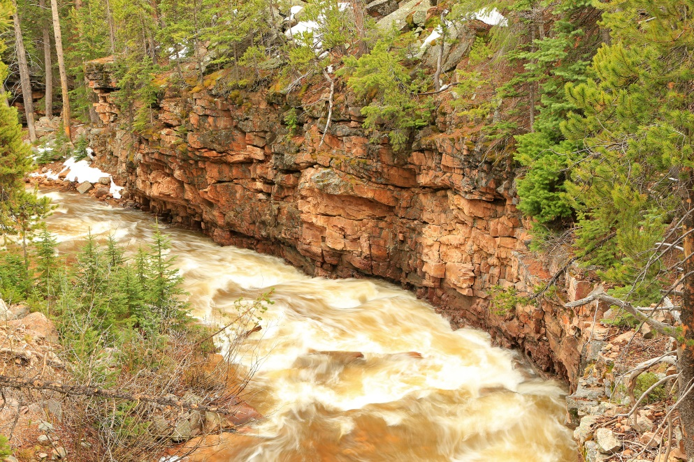
Run-Off
Can be described as the precipitation on land which reaches streams

Slide 32
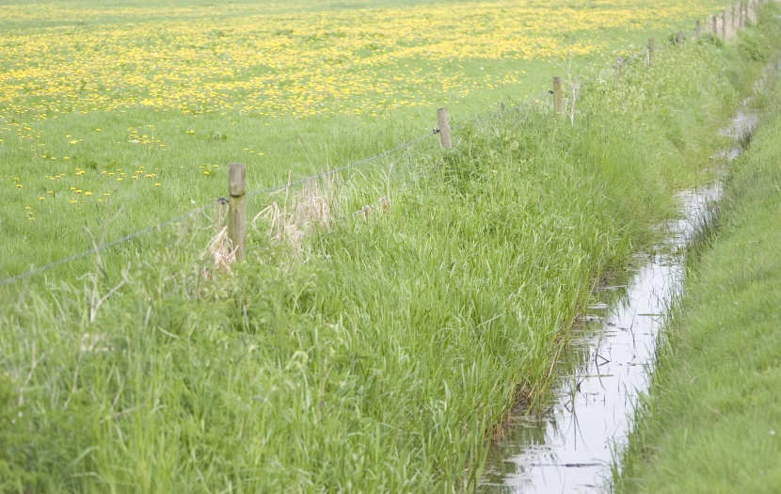
Run-Off
Is impacted by horticulture
grassy strips in fields help reduce run-off by slowing water rates in vegetated areas
plants provide a secure foundation so water will not wash sediment, fertilizers and pesticides into waterways

Slide 33
Economic Value

Slide 34
Horticulture
Has economic value
economics refer to the process in which goods and services are produced, sold and bought

Slide 35
Horticulture
Impacts the following sectors of the economy:
plant production
research
sales and marketing related products and services

Slide 36
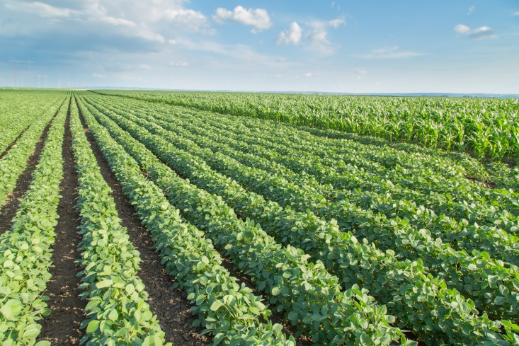
Plant Production
Is the industry responsible for the planting and cultivation of plant products including:
foods such as fruits, vegetables, grains, etc.
landscape plants
plants used in manufacturing, such as cotton
Generates more than $150 billion in the United States

Slide 37
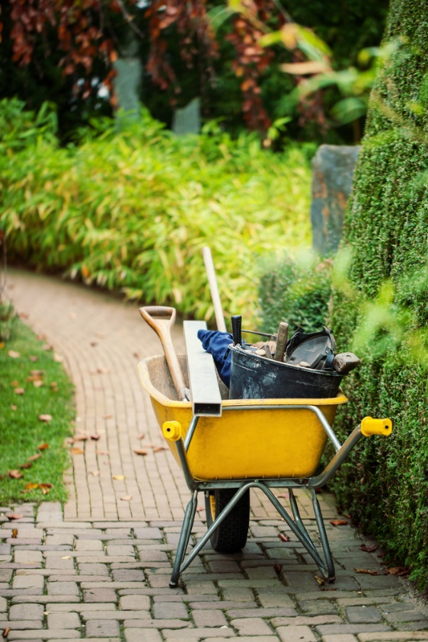
Plant Production
Provides jobs for more than 1.9 million Americans
Careers in this field include:
quality control inspector
landscape service
garden center management
food processing
orchard or greenhouse management

Slide 38
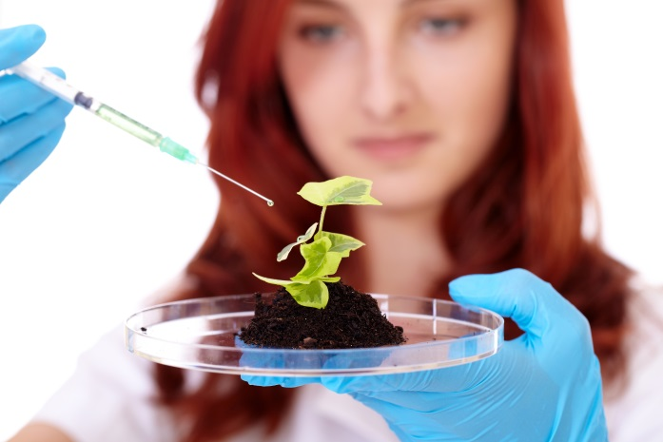
Research
Conducted through studies allow scientists from around the world to seek new pathways to enhance and document the impact of horticulture
Also shows the relationships between humans and the plant world

Slide 39
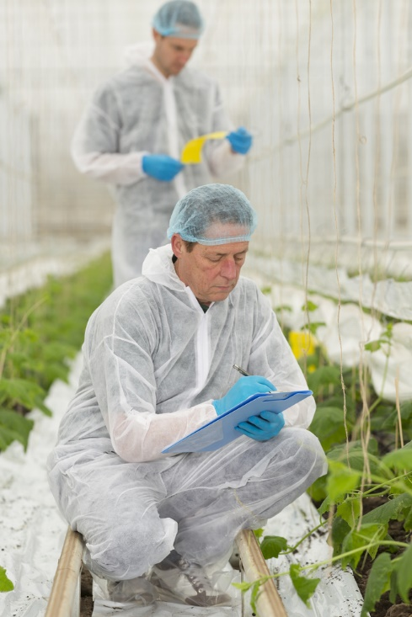
Research
Careers in this field include:
extension horticulture specialist
research associate
biological science technician
director of research and development
irrigation analyst
greenhouse research technician
Generates over $34.6 billion in the United States

Slide 40
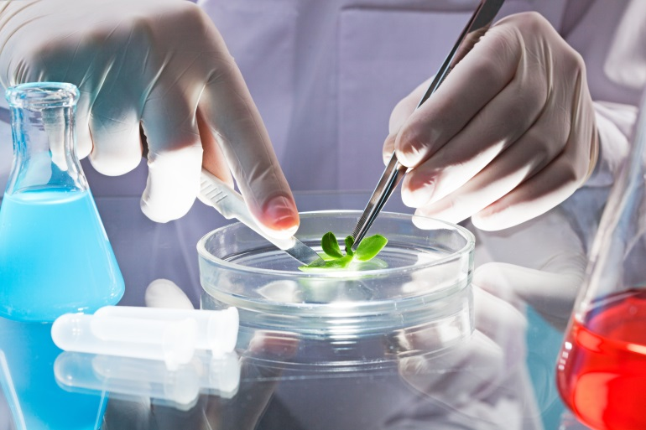
Research
Provide jobs for more than 300,000 Americans
Careers in this field include:
4-H special projects manager
research assistant and plant testing
post doctoral research associate
research scientist

Slide 41
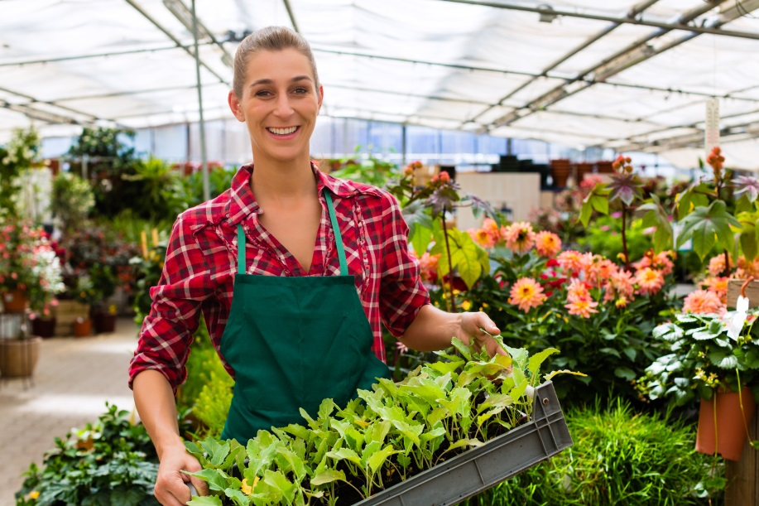
Sales & Marketing
Of horticulture products are part of a lucrative international business structure
the horticulture industry generates more $55.5 billion in the United States

Slide 42
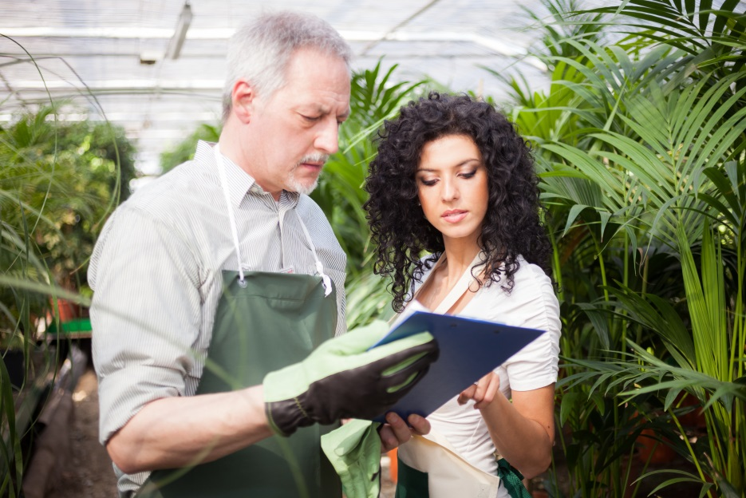
Related Products & Services
Provide many other outlets for horticulture to help generate money and add versatility to the industry
Generates more than $57.8 billion in the United States

Slide 43
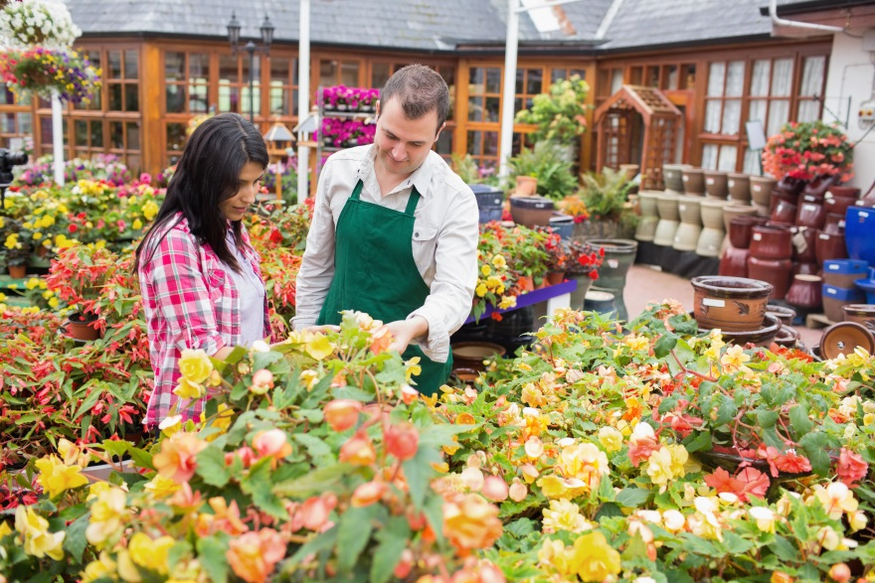
Related Products & Services
Provides jobs for more than 750,000 Americans
Careers in this field include:
processors
distributors
garden centers
nurseries
florists
teaching

Slide 44
Resources
What is a Specialty Crop? (n.d.). Retrieved August 2, 2015, from http://www.ams.usda.gov/AMSv1.0/scbgpdefinitions
Types of Grasses found in America. (n.d.). Retrieved August 2, 2015, from http://www.american-lawns.com/grasses/grasses.html
Careers in Horticulture. (2009). Retrieved August 2, 2015, from http://www.hrt.msu.edu/careers-in-horticulture/
Meyer, G. (n.d.). Water Encyclopedia. Retrieved August 2, 2015, from http://www.waterencyclopedia.com/Re-St/Runoff-Factors-Affecting.html
American Horticultural Therapy Association. (n.d.). Retrieved August 5, 2015, from http://ahta.org/research
Floriculture. (n.d.). Retrieved August 5, 2015, from http://www.agmrc.org/commodities__products/specialty_crops/floriculture/

Slide 45
Resources
Importance of vegetables. (2011). Retrieved August 5, 2015, from http://agriinfo.in/default.aspx?page=topic&superid=2&topicid=849
IMPORTANCE OF MEDICINAL PLANTS. (n.d.). Retrieved August 5, 2015, from http://www.botanical-online.com/english/importanceofmedicinalplants.htm

Slide 46
Acknowledgements
Production Coordinator
John L. Hawley
Brand Manager
Megan O’Quinn
Assistant Brand Manager
Amy Hogan
Graphic Designer
Melody Rowell
V.P. of Brand Management
Clayton Franklin
Executive Producer
Gordon W. Davis, Ph.D.
© MMXIV
CEV Multimedia, Ltd.

