Slide 1
COMMON HERD MANAGEMENT
Dana Mills

Slide 2
Producing quality beef animals is more than turning them out in pasture.
Animals must receive proper care – this is known as management practices
Areas of care:
Providing feed and water
Breeding
Disease control
Deworming
Identification
Animals should be observed daily.
Why?

Slide 3
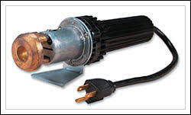
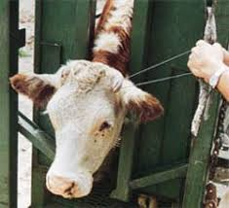
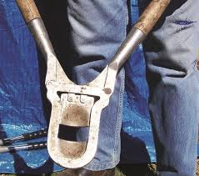
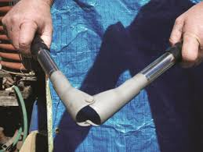
Dehorning
Is used with horned breeds of cattle to remove the horns
Large horns can be dangerous and injure other animals, as well as people
Best to do this on young cattle
Why?
Methods of dehorning
Caustic chemicals
Sawed or clipped off
Cauterized afterwards

Slide 4
Castration
Calves not wanted to be kept for breeding bulls are castrated
Castration is removing the testicles or destroying their development
Makes calves easier to handle and mange
Calf castrated at young age is known as?
These often bring higher prices than bulls

Slide 5
Castration method
Elastrator is a common way to castrate cattle
This stretches a specially made rubber band over the scrotum
This cuts off circulation and scrotum will essentially dry up and fall off
This method is best done on younger calves. Smaller the better
Knife and scalpel may be used to cut testicles from the scrotum.
Bleeding must be stopped and flies controlled
Watch close for infection
Burdizzo clamp also used
No bleeding occurs
Clamp crushes and severs the cords and blood vessels going to the testicles
Causes them to dry up.
Important to make sure the cord does not slip out of clamp and miss being crushed.

Slide 6
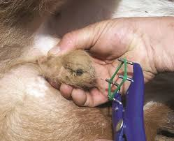
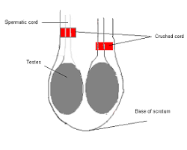
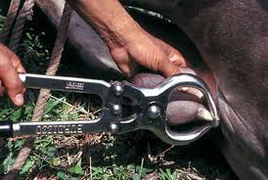
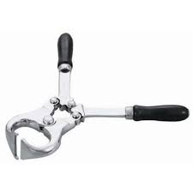

Slide 7
FACILITIES AND EQUIPMENT
Facility and equipment needed depends on the system of production and climate
Factors that assist in planning include
Number of cattle, amount of space, location, kind of facility, herd and property security, environment conditions, amount of money to invest, availability of other facilities and equipment.

Slide 8
Facilities
Can range from simple to elaborate
Should allow for flexibility to expand
Since cattle are range animals they do not need a lot of shelter but some should be available
To allow for shade and warmth in harsh weather
Fencing to keep animals confined

Slide 9
Equipment
Typed of equipment needed depends on type of animal being produced
Water tanks should be available for all cattle
Feeders should be available and allow several head to consume salt and mineral mix at a time
Feed storage to avoid waste and pest damage
Silos, metal storage bins
Feeders for hay, forages, and grain
Large enough to accommodate all cattle at once
May require more than one feeder

Slide 10
Equipment cont.
Good corral makes for easier work
Decrease labor and time, reduce stress on cattle, decease chance of injury, and increase safety for producers
Corral designs vary
Following Temple Grandin’s designs are best
Working chutes and headgates
Used to hold and restrain cattle for tagging, vaccinating, medications application

