Slide 1
Cattle breeds
Dana Mills

Slide 2
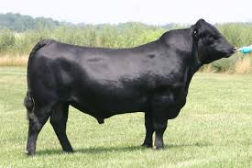
Angus
First imported from Scotland in 1873
Most popular purebred cattle
Black in color and has a smooth coat w/black skin
Few carry recessive gene for red color
Most carry dominant gene for being polled
Produce a high quality carcass that has good marbling
Increases the quality of the carcass and makes meat cuts tastier

Slide 3
Angus
Polled means: that the animal is naturally without horns
Marbling means: presence of intramuscular fat

Slide 4
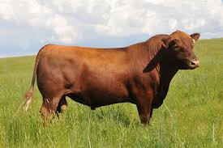
Red Angus
Breed developed from black angus in US about 1945.
Black Angus carry the recessive red gene for color were mated to produce red offspring
Similar to black angus except for color
Red angus do not absorb as much heat as black
Some what heat tolerant

Slide 5
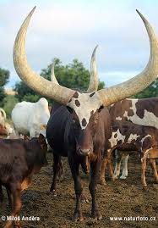
Ankole Watusi
Originated in the Ankole District of Uganda, Africa
Not widespread in US
Colors include dark red, black, white, gray, and yellow
Largest horns of any beef cattle
Horns are said to serve the animal by casting-off excess heat
Recessive genes result in variety of the animal including dwarfism and some that are polled
Notes:
Horns may reach 8 feet in total length, with a diameter of 9 inches at the base.

Slide 6
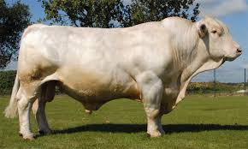
Charolais
Old breed developed in central France
The first ones were introduced in 1963 by King Ranch in TX
Cattle are white or off-white in color w/ pink skin
Large framed, heavy muscled breed
Can be polled or horned
Commonly used in crossbreeding programs to increase frame size and muscle

Slide 7
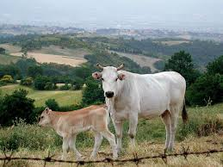
Chianina
Originated in Chiana Valley of Italy
Perhaps, one of the oldest breeds in the world
Introduced in US in 1971, when semen was first imported
Large framed and commonly used in crossbreeding.
Good maternal traits
Improve growth rate of the offspring
Color varies
Original Chianina white with black tail switch and black skin pigment

Slide 8
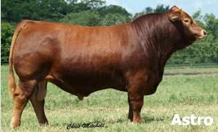
Gelbvieh
Developed by crossing four yellow breeds of cattle
Glan-donners-burg, Yello Franconian, Limburg, Lahn
Orginated in 1920
Varry in color from cream to reddish yellow and even black in recent years
Medium framed
Produce an acceptable carcass
High Milking ability

Slide 9
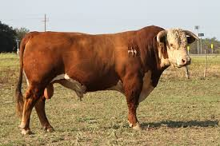
Hereford
Originated in Hereford County, England
Imported by Henry Clay to Kentucky
Believed to be established in 1840s in NY
White faces and red bodies
White feather or stripe on the top of necks
Aka feather neck
Predominantely white on belly, legs, and switch
Are horned, docile, easy to handle
Moderate frame size

Slide 10
Hereford cont.
Extremely good foragers
Forager means:
Animal that makes especially good use of grasses and plants for food
Very hardy breed
Foraging ability and hardiness make this breed popular to the grazing regions of the western US
Hereford are commonly known as “Whiteface”

Slide 11
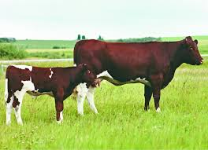
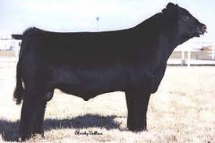
Maine-Anjou
Originated in France in early 1800s
Developed through cross-breeding English Shorthorn and French Mancelle breeds
Originally used as draft animals
Beef traits developed through selective breeding
Introduced in US in 1970s through imported semen from Canada

Slide 12
Maine-Anjou cont.
Are a dark cherry red and white in color
Light pigmentation in skin
Commonly used in crossbreeding
From this black Maine-Anjous have been developed
Usually horned and moderate framed
Generally docile and easy to handle
Grow quickly
Have good marbling in carcasses

Slide 13
Salers
Developed in central France and recently brought to US
Established in 1973 when semen was imported
Deep cherry red and sometimes will have white on their bellies
Noted for their calving ease
Smaller heads and long slender necks and bodies
Females milk quite well

Slide 14
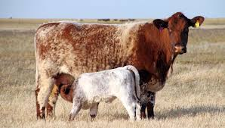
Shorthorn
Originated in northern England around 1600
Originally developed as a dual-purpose breed.
Used for both milk and meat production
Introduced in US in 1783 in Virginia
Called are red, white, or roan
May be either polled or horned
Moderate frame size
Females good mothers and milk exceptionally well
Generally gentle and have good dispositions

Slide 15
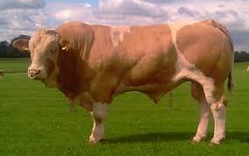
Simmental
Developed in Western Switzerland and quite popular in Europe today
Dual-purpose breed included draft animals
Brought to US in 1969 from Canada
Have cream-colored face with light yellow, red, or spotted body
Some have color pigmentation around eyes
Horned or Polled
Large-framed, heavy-muscled, and produces lean carcasses

Slide 16
South Devon
Developed in western region of England
Bred for their dual-purpose
Imported into the US in late 1930s and early 1940s
Popularity increased in 1970 when they were started to be used for crossbreeding
Medium-red color
Usually Horned

Slide 17
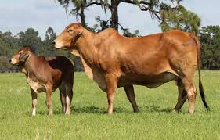
Brahman
Developed in Southwestern part of the US
Thought to developed between mid 1800s and early 1900s and originated from India
Also known as Zebu cattle
Have a distinctive hump between shoulders
Selected because of hardiness, resistance to insects and disease, heat tolerant
Females good mothers
Prosper on poor-quality forage
Temperament – unpredictable
Vary in color

Slide 18
Brangus
cross between Brahman and Angus
Developed at US department of AG Experiment in LA in 1912
Similar to angus and Brahman
Solid black in color and polled
Long floppy ears and loose hide
Adaptable to various climates
Good mothering abilities

Slide 19
Santa Gertrudis
Developed around 1918 on King Ranch in TX
Cross of Brahman and Shorthorn Cattle
Deep cherry red and may be horned or polled
Many characteristics for Brahman including loose skin and long ears
Very adaptable to warmer climates and more resistant to disease and insects

Slide 20
Beefmaster
Developed in 1931 in TX
Breed is result of crossing Herefords, shorthorns, and Brahmans
Color varies but reds and yellowish-whites are common
Hardy breed
Milk well

Slide 21
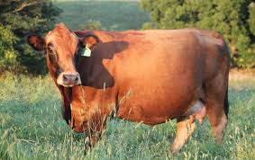
Tarentaise
Originated in French Alps in 1859
Brought to North America in 1973 with importations into Canada
Hardy breed
Relatively free of eye cancer and udder burn because of dark pigment around the eyes and on the udder
Wheat-colored
Ranging from cherry to dark blonde
Black pigment on muzzle, eyes, and udder.

Slide 22
Belted Galloway
“Oreo Cow”
Medium framed
Lean
Longer hair coat

Slide 23
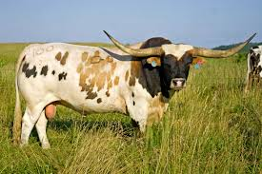
Texas Longhorn
Originated in Texas
Large-frame
Long distinct horns
Adaptable to harsh environments

Slide 24
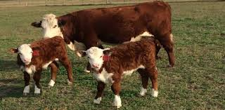
Polled Hereford
Originated in Iowa in 1901
Same basic traits as Herefords, except they don’t have horns
4 bulls and 10 cows (all polled developed foundation)

Slide 25
Limousin
Originated in France
Introduced in US in 1968 when semen imported from Canada
Either a light yellow or an orange in color
Area around muzzle will generally be lighter version of body color
Horned and polled found in this breed
Moderate, heavy-muscled frames
Noted for carcass leanness and large loins
High in cutability
Cutability; amount and quality of salable retail cuts that may be obtained from a carcass

Slide 26
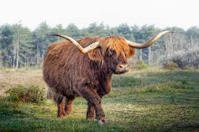
Scottish Highland
Originated in Scotland
Long coat for insulation
Large framed
Lean meat
Horned

Slide 27
Bovine Skeletal Anatomy

Slide 28
Bovine External Anatomy

