Slide 1
Small Engine tool, parts & Equipment
Dana mills

Slide 2
ENGINE PRECISION MEASURING TOOLS

Slide 3
Engine precision measuring tools
Are used to accurately measure components when very small tolerances are allowed
to make sure components conform to standards and all parts fit together once the product is built
Fun fact: tolerance refers to the dimensions and or properties having some variation without affecting the functions of the engine

Slide 5
Engine precision measuring tools
Include:
micrometers
telescoping gauge
small hole gauges
digital caliper
feeler gauges
dial indicator
surface plate
torque wrench

Slide 6
Micrometers
Are handheld devices used to measure the thickness of valve stems and other materials
down to one thousandth of an inch or to one ten thousandths of an inch
Consist of a C-shaped head and a rotating dial handle with measurements
Can be calibrated by a technician
Require following the manufacturer’s directions when using or calibrating

Slide 7
micrometers
Precisely measure components in which tolerances are critical, including the following:
pistons
crankshafts
valve stems
cylinders
rings
other small engine components

Slide 8
micrometers
Types of micrometers include:
outside micrometer
measures the outside diameter of round objects and the thickness of flat pieces
inside micrometer
measures the inside diameter of a cylinder or ring
depth micrometer
measures the depths of holes, grooves and slots
Vernier micrometer
measures more precisely than standard micrometers

Slide 9
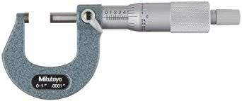
Outside Micrometer

Slide 10
Parts of micrometer

Slide 11
Micrometer units
May be metric or imperial
imperial units are known as customary units (i.e., inches, feet, miles, etc.)
Are as follows:
standard micrometers are graduated in thousandths of an inch (.001”)
Vernier micrometers are graduate in ten-thousands of an inch (.0001”)
metric micrometers are graduated in hundredths of a millimeter (.01mm)

Slide 12
Reading a micrometer
Involves understanding the following components:
sleeve
does not move
thimble
rotates around the sleeve

Slide 13
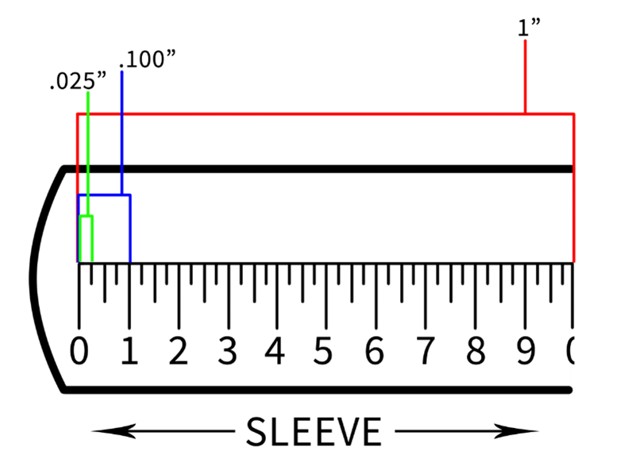
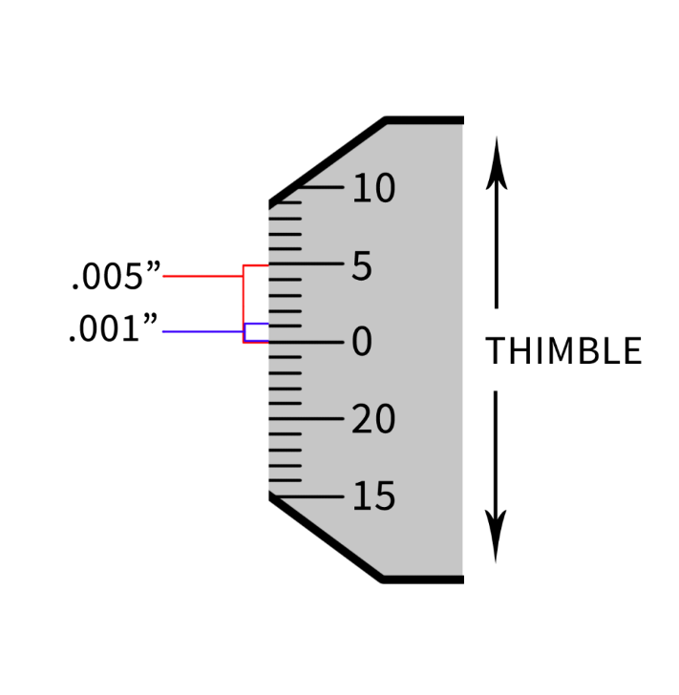
Reading a micrometer (1” standard)
Sleeve
is divided into 40 equal parts
each line represents 0.025”
every fourth line is numbered and represents 0.1”
Thimble
is divided into 25 equal parts
each line represents 0.001”
every fifth line is marked and represents 0.005”

Slide 14
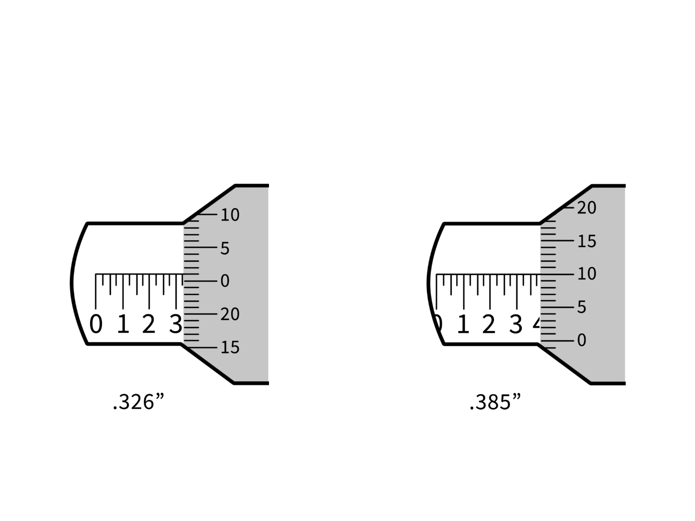
Examples

Slide 15
Micrometer maintenance
Includes:
regularly wiping the spindle and both measuring faces with a dry cloth in order to keep clean
applying multipurpose oil to prevent rusting
avoiding storing in humid climates or extreme temperatures
avoiding leaving the spindle and anvil in contact
could alter the accuracy
store in a protective case when not in use
May be necessary if the micrometer is dropped
which can alter the accuracy of the measurement

Slide 16
Micrometer Use & safety
Include:
cleaning the anvil before measuring
holding the micrometer square and level
if it is at an angle, measurement will not be accurate
holding the micrometer with the dominant hand
making certain to not overtighten the thimble
using the micrometer according to manufacturer’s instructions

Slide 17
Telescoping gauges
Are transfer measuring tools, which transfer a measurement to a micrometer
Are made to measure holes where inside micrometers are unable to fit
Expand under spring tension within a hole to be measured and then locked into position after the measurement has been taken
Does not provide a direct measurement

Slide 18
Telescoping gauge

Slide 19
Maintenance
Telescoping Gauge Maintenance Includes:
cleaning after each use
avoiding storing in the same area as hand tools
which may bump or damage the gauges
storing in a protective case when not in use
avoiding exposure to high temperatures
repairing at an authorized facility

Slide 20
Use & Safety
ensuring the handle is in line with the center-line of the cylinder being measured
ends must be exactly aligned with the true diameter of the cylinder
moving the gauge up and down the cylinder causing the spring tension to reach a true diameter
when a true diameter has been reached, gently tighten the lock screw, then once it is locked, tilt the handle so the tool can be removed from the cylinder and a measurement can be taken with a micrometer
using the telescoping gauge according to manufacturer’s instructions

Slide 21
Small hole gauges
Are similar to a telescoping gauge
Are measuring tools with an expandable head
Are used for measuring small diameter holes which a telescoping gauge cannot fit into
Require a working micrometer to read the measurements taken

Slide 22
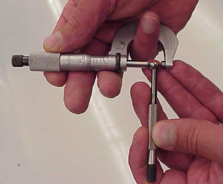
Small hole gauge

Slide 23
Maintenance
cleaning after each use
avoiding storing in the same area as hand tools
which can bump and damage the gauges
storing in a protective case when not in use
avoiding exposure to high temperatures
only repairing at an authorized facility

Slide 24
Proper Use & safety
placing the head of the gauge into the hole which needs to be measured and turning the handle until the sides of the head are touching the sides of the hole, then measuring with an outside micrometer
using the gauge according to manufacturer’s instructions

Slide 25
Feeler gauges
AKA “thickness gauges”
Rely on the users sense of touch for measurements and are used to measure small spaces between surfaces, including:
spark plug
crankshaft endplay
piston ring
Consists of metal leaves which vary in thickness and each leaf has its own measurement on the handle

Slide 26
Feeler gauges

Slide 27
Units
Typically in the thousandths of an inch and/or hundredths of a milliliter
Typically laser-etched on the end of the blade

Slide 28
Maintenance
Wiping clean before and after each use
Avoid taking measurements over any markings on blades
This avoids unnecessary wear of markings

Slide 29
Proper use & Safety
keeping blades folded together and stored in their protective housing when not in use
avoiding various components which may cause injuries from pinching
keeping fingers a safe distance from the parts being measured
using caution when working around electrical components

Slide 30
Digital caliper
Is a precision measuring tool which is used to measure internal and external distances
Digitally displays measurements on an LCD screen
Can be measured in millimeters or inches (metric/imperial)

Slide 31
Types of calipers
Vernier calipers
have a sliding scale along the top and bottom
dial calipers
display measurement with a pointer
electronic digital calipers
have an LCD screen which displays measurements
What kind do we have?

Slide 32
Digital caliper

Slide 33
Parts of caliper

Slide 34
Maintenance
cleaning after each use
avoiding storing in the same area as hand tools
which can bump and damage the caliper
storing in a protective case when not in use
avoiding exposure to high temperatures
only repairing at an authorized facility

Slide 35
Use & safety
using the caliper on work pieces which have been de-energized and are no longer moving
using the caliper according to manufacturer’s directions
zeroing the dial each time after the caliper is used

Slide 36
Dial indicators
Used to measure movements of components in fractions of an inch or millimeters
Consist of a dial attached to a needle
Can be used to determine crankshaft end play

Slide 37
Types of dial indicators
probe indicator
dial and needle connected to gears inside the indicator
measures in millimeters or inches
dial test indicator
measures smaller range than the probe indicator
digital indicator
uses a digital readout instead of a clock face
making recording data much easier
measures in millimeters or inches

Slide 38
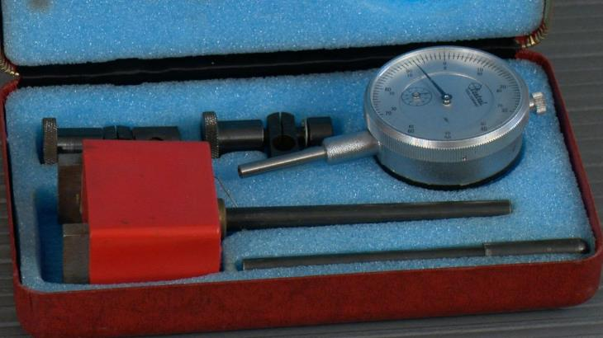
Dial indicator

Slide 39
Adjustments
setting the dial indicator to zero by rotating the bevel until the zero line is directly under the needle

Slide 40
Maintenance
cleaning after each use
avoiding storing in the same area with hand tools
which can bump and damage the gauges
storing in a protective case when not in use
avoiding exposure to high temperatures
repairing and calibrating at an authorized facility
technicians should never attempt to repair broken dial indicators on their own

Slide 41
Use & safety
always keeping hands clear of rotating machinery during use
stopping all moving parts to be measured before attaching the dial indicator
attaching a dial indicator according to manufacturer’s instructions

Slide 42
Torque wrench
Measures the specific torque applied to a fastener such as a bolt
torque is the force which causes rotation
Helps ensure a fastener will not break

Slide 43
Types of torque wrenches
Include:
electric
click
beam
plumber
hydraulic
deflecting beam

Slide 45
Maintenance
checking periodically for wear or defective parts
the more the wrench is used the more wear it will have
keeping the wrench in a case to protect the tool from dust, grime and other hazards
keeping the wrench dry and clean
storing wrenches with a spring mechanism at the minimum setting when not in use
leaving wrenches on a high setting can distort the calibration causing inaccurate measurements

Slide 46
Use & safety
reading all instructions
each torque wrench has different instructions for use, maintenance and service

Slide 47
Surface plate
Is a solid, flat plate which is used for inspections, layout and setting up tools
Helps measure whether an object is flat, level or neither
for example, bends which are not obvious to the eye

Slide 48
Surface plate

Slide 49
Maintenance
cleaning after each use
repairing and calibrating according to the manufacturer’s manual

Slide 50
Use & safety
oiling the plate if it has not been used for an extended period of time
wiping the surface with a small amount of oil so it does not rust
never hammering or completing any other operations on the plate
could cause damage to the plate

